Slide 1
Introduction to SQL Server Integration Services-2008
Nand Kishor Kumar
September, 2017

Slide 2
Agenda
What is SSIS?
Why SSIS?
Building blocks of SSIS
Create your first SSIS package
Advantages of SSIS

Slide 3
What is SSIS?

Slide 4
What is SSIS?
SQL Server Integration Services is an ETL tool.
E- Extract - Extract means retrieve data from any data source like SQL Server, Oracle, Sybase, DB2, MS Access, MySQL, MS Excel, CSV, XML, Cloud DB, Flat file etc.
T- Transform - Transform perform various transformations on the data; e.g. convert from one type to another, convert to uppercase or lowercase, perform calculations, concatenate two or more columns etc.
L- Load - Load data into end target (database, Flat file etc.)

Slide 5
Why SSIS?

Slide 6
Why SSIS?
Export data
Import data
Transferring data from one data source to another
Merge data from heterogeneous data sources into SQL Server or other database
Populate data warehouses, clean and standardize data
To automate administrative tasks

Slide 7
Building blocks of SSIS

Slide 8
Building Blocks of SSIS
Control Flow -Control flow deals with flow of Tasks, and these tasks are linked through precedence constraints. A subsequent task does not initiate unless its predecessor has completed. For example you put two operations: execute t-sql command on a database and send mail. Then you define order of them with Precedence Constraint for example the t-sql statement should be executed and then if it succeeded mail will be send.
Data Flow - A data flow defines a flow of data where data comes from (data sources), how data should be transformed (transformations) and where data should be loaded (data destinations).
Event Handler – Whenever some error occurs we can handle that error in Event Handler. Frequently used Event Handlers are OnError, OnInformation, OnProgress, OnTaskFailed, OnWarning etc.
Package Explorer - Package Explorer tab help us to see a hierarchical view of all of the elements in a package: configurations, connections, event handlers, executable objects such as tasks and containers, log providers, precedence constraints, and variables.
Precedence Constraints – Precedence constraints help us create a work flow in a SSIS package. With the help of precedence constraints we can connect tasks to control the flow. Based on the configuration, the precedence constraints can be represented as solid or dotted lines with green, red or blue color. The precedence constraint line is green for Success, red for Failure, and blue for Completion.
    Success: The precedence executable must run successfully for the constrained executable to run. This is the default value. The precedence constraint is set to green when the Success option is selected.
    Failure: The precedence executable must fail for the constrained executable to run. The precedence constraint is set to red when the Failure option is selected.
    Completion: The constrained executable will run after the precedence executable runs, whether the precedence executable runs successfully or whether it fails. The precedence constraint is set to blue when the Completion option is selected.

Slide 9
Building Blocks of SSIS
Connection Manager - The Connection Managers area lists the added connection managers and it appear at bottom of the package designer. Frequently used connection manager types are ADO.NET, OLEDB, ODBC, FLATFILE, EXCEL etc.
Tool box - All components that are installed on the local machine, including third-party components automatically appear in SSIS Toolbox. When we install additional components, right-click inside the toolbox and then click Refresh Toolbox to add the components. With the help of these tools we design our package.
Variables - A variable is used to store the value that can be referenced by various SSIS components throughout the package’s execution. We can configure a variable so its value is updated at run time, or we can assign a value to the variable when we create it. There are two types of variables in an SSIS package: System and User-defined. SSIS automatically generates the system variables when we create our package and we create User-defined variables as needed when setting up our package. However, both variable types store data that tasks and containers can access during a package’s execution.
Configuration –SSIS provides package configurations that we can use to update the values of properties at run time. For example, by using a configuration, we can change the connection string of a connection manager, or update the value of a variable.
Logging – SSIS log provider is used to implement logging in package, container, and tasks. With logging, we can capture run-time information about a package, helping us to audit and troubleshoot a package every time it is run. For example, a log can help us to capture the package began time and finished time.

Slide 10
Create your first SSIS package

Slide 11
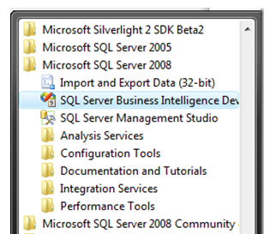
Create your first SSIS package
SSIS can be found in the SQL server 2008 group as shown below.
Select File —-> New —–> Project. In the New Project dialog box, select the Integration Services Project template. Then, provide a name for the project in the Name text box.

Slide 12
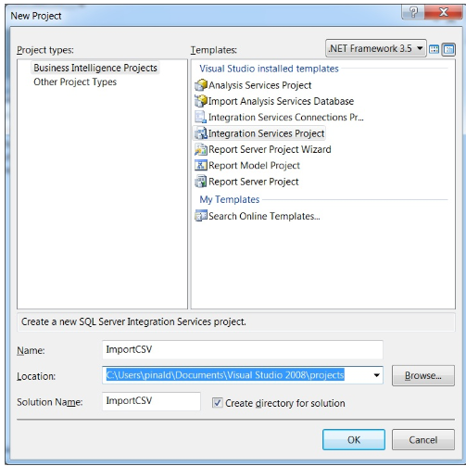
Create your first SSIS package
After you’ve entered the project and solution information, click OK.

Slide 13
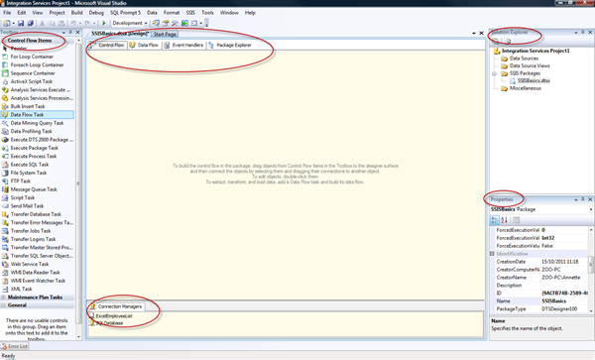
Create your first SSIS package
Your new package will open in the SSIS window, as shown below.

Slide 14
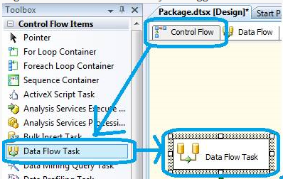
Create your first SSIS package
From tool box drag and drop a Data Flow Task to the Control Flow tab.
Inside the Data Flow tab, we’ll define our OLE DB Source and Flat File destination as well as which columns of data to move where.

Slide 15
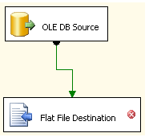
Create your first SSIS package
Double click on OLE DB Source object, and connect to the database and table to configure the data source for reading.
After the connection is build, we can now configure the Data Flow Destination component Flat File Destination. Double click on the item to configure the Flat File connection manager. In Flat File Format screen, we will be requested to choose flat file format among available formats: delimited, fixed width, fixed width with row delimiters, and tagged right.

Slide 16
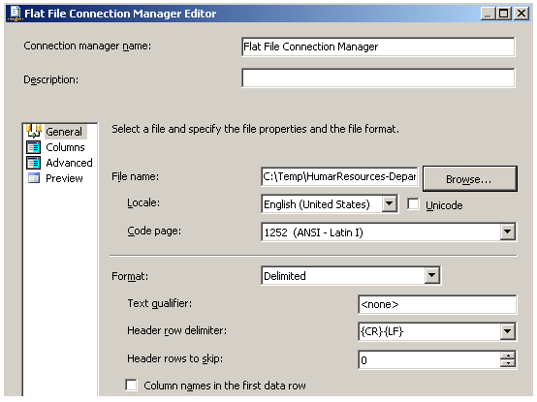
Create your first SSIS package
Now our sample SSIS package is completed. We can now test if we can export data in SQL Server database table to flat file in selected file folder. To test the SSIS package, use F5 (Start Debugging) or Ctrl+F5 (Start Without Debugging) options from Debug menu.

Slide 17
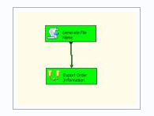
Create your first SSIS package
The following screen shows the successful execution of the SSIS package.

Slide 18
Advantages of SSIS
Friendly Graphical User Interface
Different types of tasks in single package
Parallel execution
Connect to different data sources
Can be scheduled
Deploying SSIS package is very easy
Cost effective

Slide 19
Thanks!

